Slide 1
Binary Heaps
Delete-min
Building a heap in O(n) time
Heap Sort

Slide 2
Delete-min
The minimum element is the one at the top of the heap.
We can delete this and move one of its children up to fill the space.
Empty location moves down the tree.
Might end up at any position on last level.
Resulting tree would not be left filled.

Slide 3
Delete-min in a Heap
8
10
11
18
21
13
12
43
23
26
29
31
19
17
This is not a heap

Slide 4
Delete-min in a Heap (2)
Replace top element with last element of heap.
Heapify(1)
8
10
11
16
21
13
12
43
23
26
29
31
19
17

Slide 5
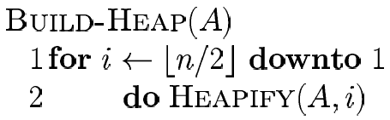
Building a heap
We start from the bottom and move up
All leaves are heaps to begin with
23
43
26
10
21
13
31
16
12
8
29
11
19
17

Slide 6
Building a Heap: Analysis
Correctness: induction on i, all trees rooted at m > i are heaps
Running time: n calls to Heapify = n O(lg n) = O(n lg n)
We can provide a better O(n) bound.
  Intuition: for most of the time Heapify works on smaller than n element heaps

Slide 7
Building a Heap: Analysis (2)
height of node: length of longest path from node to leaf
height of tree: height of root
time for Heapify(i) = O(height of subtree rooted at i)
assume n = 2^{k} – 1 (a complete binary tree)

Slide 8
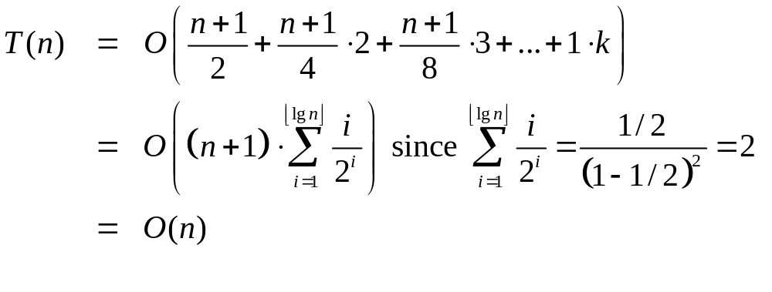
Building a heap: Analysis (3)
For the n/2 nodes of height 1, heapify() requires at most 1 swap each.
For the n/4 nodes of height 2, heapify() requires at most 2 swaps each.
For the n/2^{i} nodes of height i, heapify() requires at most i swaps each.
So total number of swaps required is

Slide 9
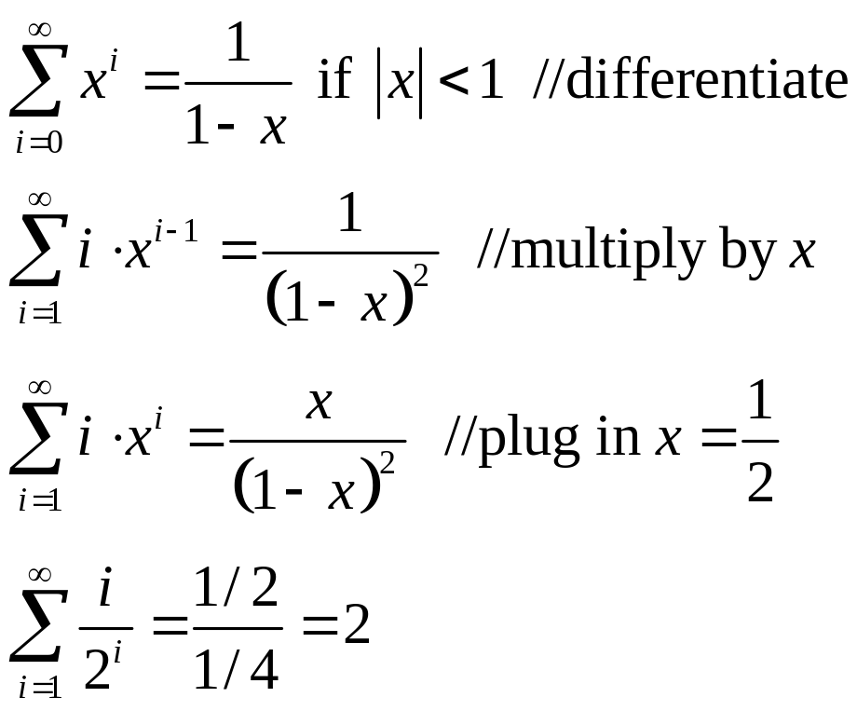
Building a Heap: Analysis (4)
How? By using the following "trick"
Therefore Build-Heap time is O(n)

Slide 10
Heap Sort
Create a heap.
Do delete-min repeatedly till heap becomes empty.
To do an in place sort, we move deleted element to end of heap.
8
10
11
12
21
13
17
16
23
43
29
26
19
31

Slide 11
Running times of heap operations
Insert: O(log n)
Heapify: O(log n)
Find minimum: O(1)
Delete-min: O(log n)
Building a heap: O(n)
Heap Sort: O(nlog n)

